Slide 1

Viva Connections & SharePoint Framework Bi-weekly sync
aka.ms/m365pnp
Your host in this call: Patrick Rodgers
Call begins at 7:00 AM PT / 3:00 PM GMT
June 2, 2022
Microsoft 365 PnP Team

Slide 2
Viva Connections & SharePoint Framework Bi-weekly sync
aka.ms/m365pnp
Your host in this call: Patrick Rodgers
June 2, 2022
Microsoft 365 PnP Team

Slide 3






Agenda
Latest update on SharePoint Framework
Patterns and Practices Updates
PnPjs
CLI for Microsoft 365
Reusable PnP SPFx controls
New Community Samples
Picture time with Together Mode!
Demos
Arun Kumar Perumal – Frequently Asked Questions with Property Field Collection Data
Fabio Franzini - Solve Theme problems with the "Enhanced Theme Provider" PnP control
Alex Terentiev & Vesa Juvonen – Getting started on building custom list forms with SharePoint Framework 1.15 – updated story
Have a great day! 👍
You are awesome! 🧡
Thank you for being part of the community 👏

Slide 4
Opportunities to Participate in PnP SPFx / JS SIG
SPFx Demo
@pnp Demo
Contribute on GitHub
Provide Feedback
Web Part
Application Customizer
Provisioning
Anything you create!
PnPjs
CLI for Microsoft 365
SPFx Reusable Controls
SPFx Community Yeoman
Report Issues
Submit Pull Requests
Help with issues/questions
How are the calls?
Documentation needs?
Where can we help?
Positive is OK too!
Great opportunity to get visibility for you or your company. Demo sample or explain how you extend or customize SharePoint Online with live demo in your projects. Reach out to team for volunteering.
Request a demo spot on the call
https://aka.ms/m365pnp/request/demo

Slide 5
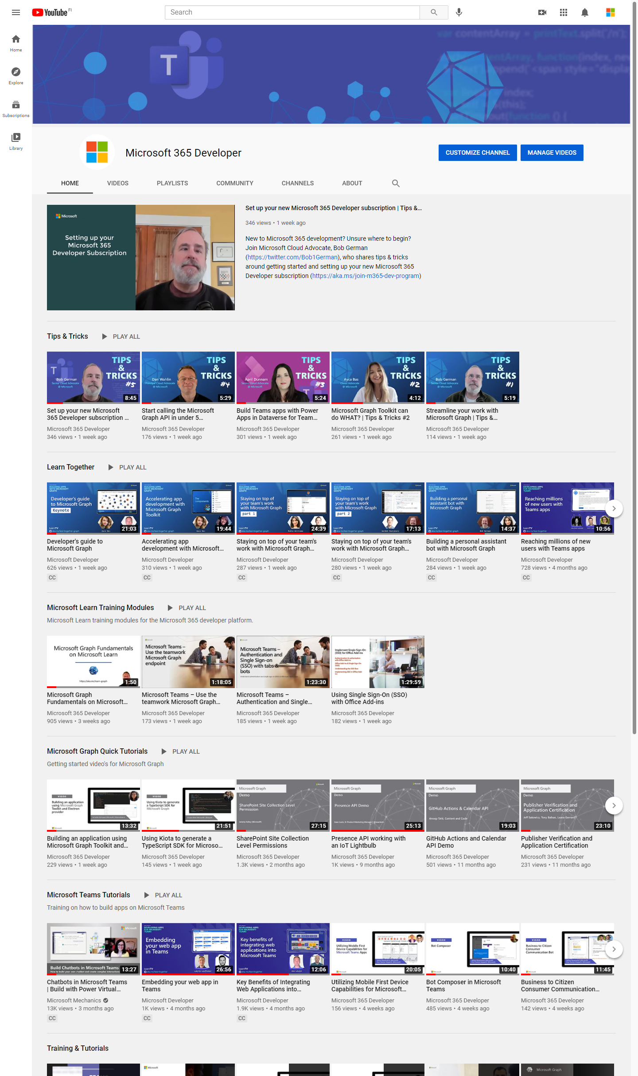
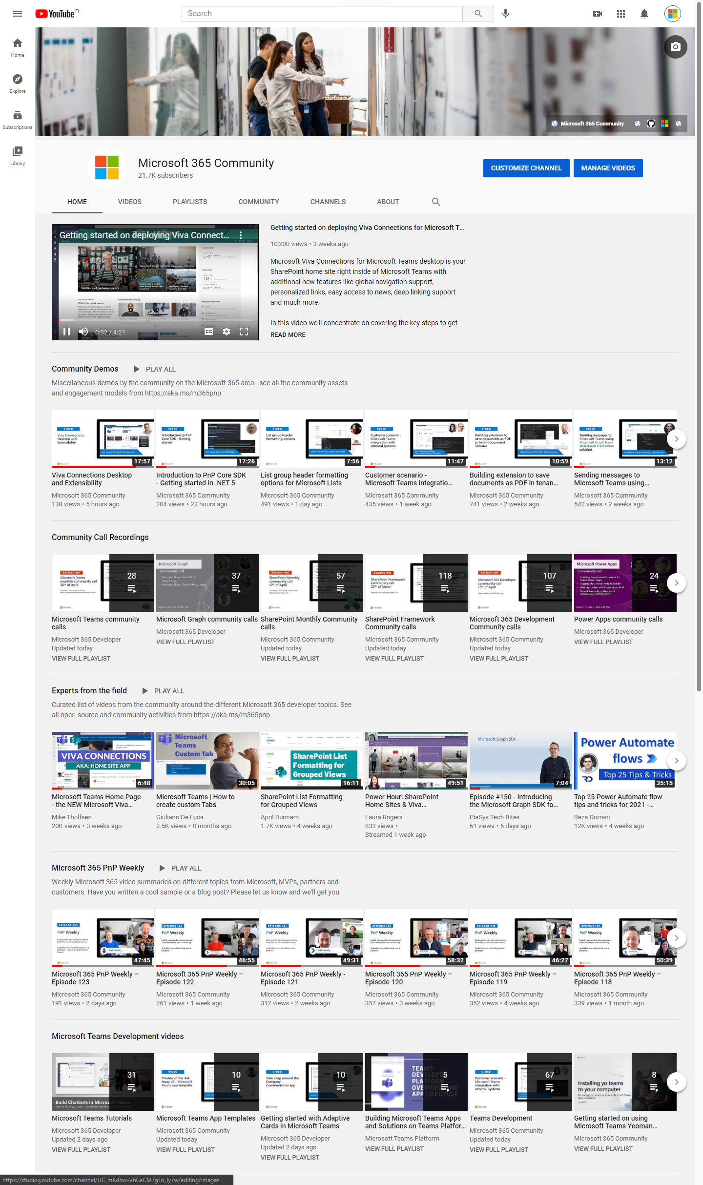
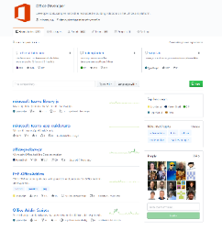
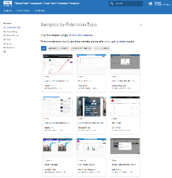
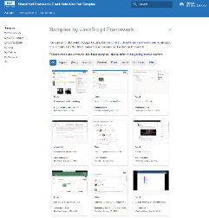
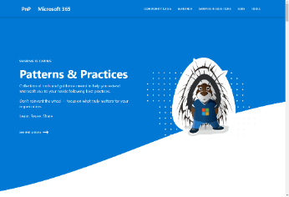
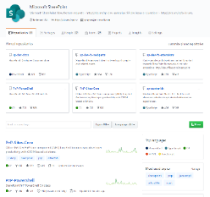
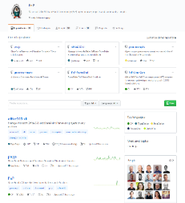
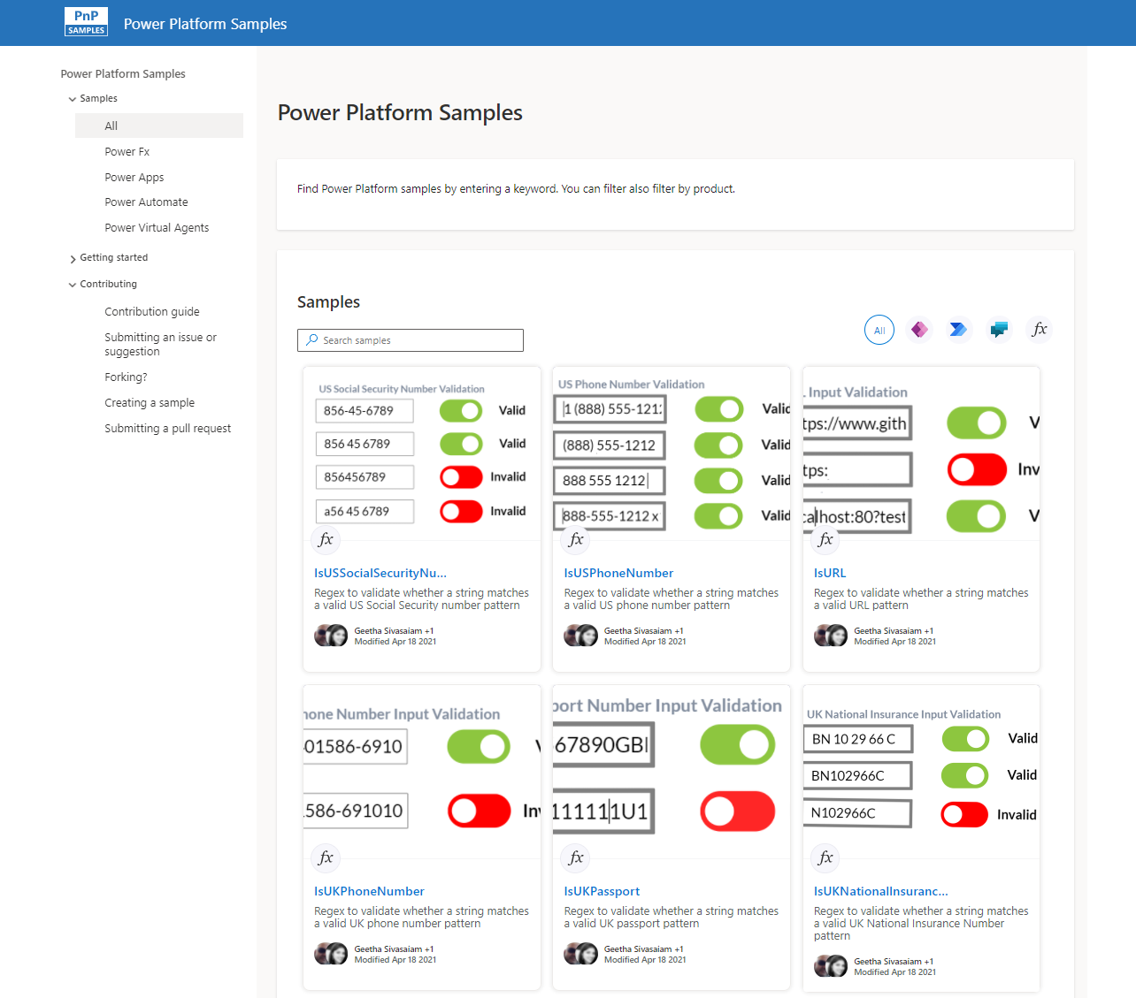
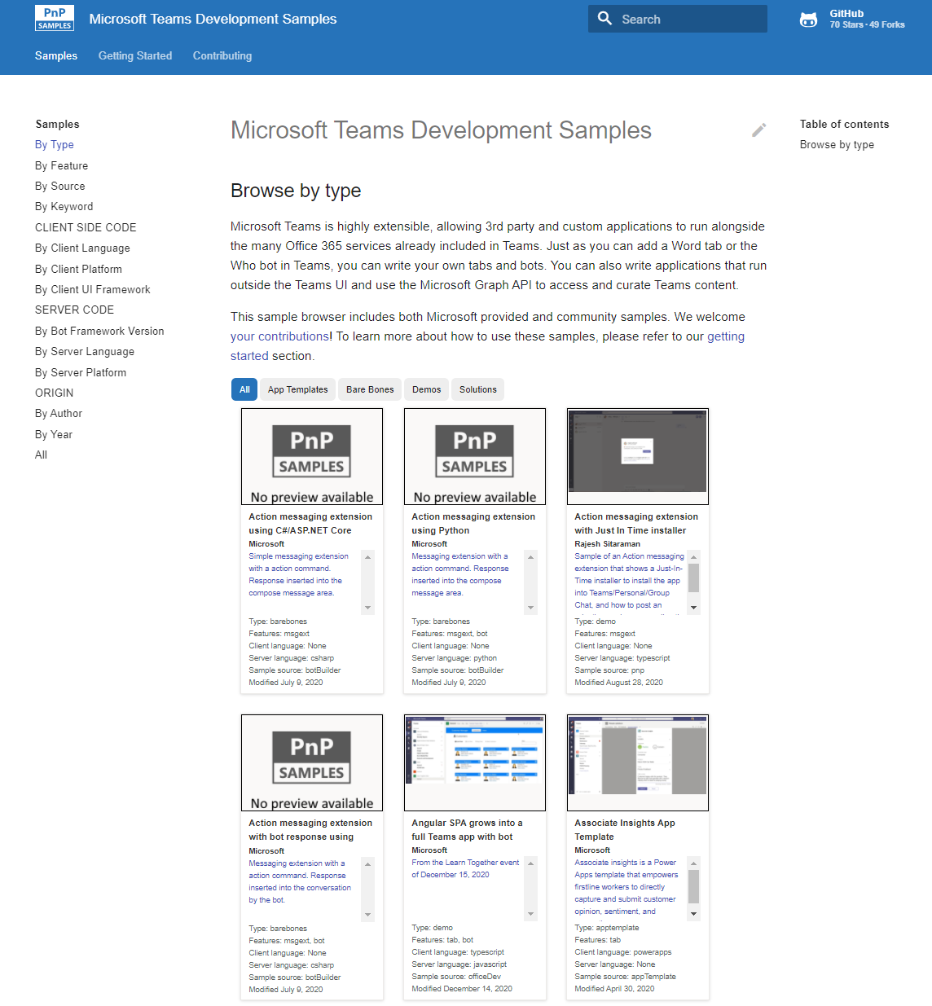
Microsoft 365 developer videos
Microsoft 365 community videos
Open-source
Sample galleries
Open-source initiatives and samples
aka.ms/m365devyoutube
aka.ms/m365/videos
github.com/pnp
github.com/officedev
github.com/microsoftgraph
github.com/sharepoint
aka.ms/m365/samples
aka.ms/teams-samples
aka.ms/spfx-webparts
aka.ms/spfx-aces
aka.ms/powerplatform-samples
aka.ms/spfx-extensions
aka.ms/list-formatting
aka.ms/m365/community
@Microsoft365Dev | @m365pnp
One URL to rule them all…

Slide 6
Microsoft 365 developer community calls
Microsoft 365 platform (weekly) https://aka.ms/m365-dev-call
(Notice. This call is on a summer break between July 1st and 31st of August 2022)
Adaptive Cards https://aka.ms/adaptivecardscommunitycall
Microsoft identity platform https://aka.ms/IDDevCommunityCalendar
Office Add-ins https://aka.ms/officeaddinscommunitycall
Power Platform https://aka.ms/PowerPlatformCommunityCall
Microsoft 365 and Power Platform community (bi-weekly) https://aka.ms/m365-dev-sig
Viva Connections & SharePoint Framework (bi-weekly) https://aka.ms/spfx-call
Download recurrent invites from
https://aka.ms/m365/calls
Notes:
m365-dev-sig

Slide 7







Latest news from Microsoft engineering on Microsoft 365 topics
Monthly community contributors
Community together mode group photo
Zac Sun- Migrate your SharePoint workflows to Power Automate with migration tooling (preview)
Dan Wahlin - Send a SMS message with Azure Communication Services
Bob German - TeamsJS SDK V2 to extend your Microsoft Teams solutions to Outlook and Office
AGENDA
Microsoft 365 platform call 7th of June @ 8 AM PT
Weekly call with Microsoft presenters covering the latest Microsoft 365 platform updates
Download recurrent invite from https://aka.ms/m365-dev-call
Notes:
Dan’s slide

Slide 8
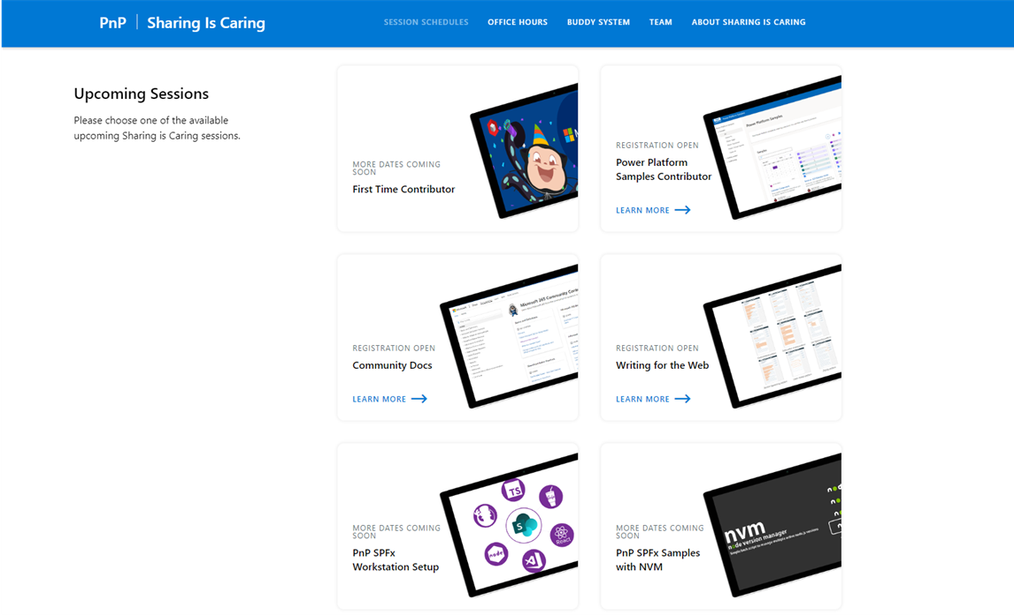
GUIDANCE
Learn how to get started in the open-source PnP community!
Upcoming Sessions:
First-time contributor
Power Platform Samples Contributor
Writing for the Web
Community docs
Using PnP SPFx samples w/ NVM
SPFx developer workstation setup
More than code with VS Code
First-time presenter
M365 Maturity Model Practitioners
Power Platform – Power Pages – Coming Soon!!!
https://aka.ms/sharing-is-caring
Notes:
25 Total attendees, 16 attendees who attended both First-Time Contributors and Community Docs sessions.

Slide 9





COMMUNITY
PnP Recognition Program
Showcase your contributions
Powered by Credly
More achievement levels coming soon
https://aka.ms/m365pnp-recognition
Notes:
25 Total attendees, 16 attendees who attended both First-Time Contributors and Community Docs sessions.

Slide 10
SharePoint Framework Latest from Microsoft engineering for Microsoft Viva, Microsoft Teams and SharePoint extensibility

Slide 11
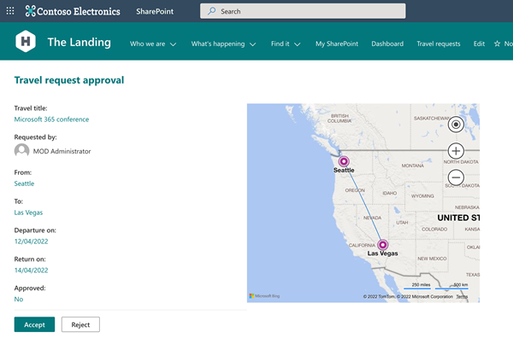
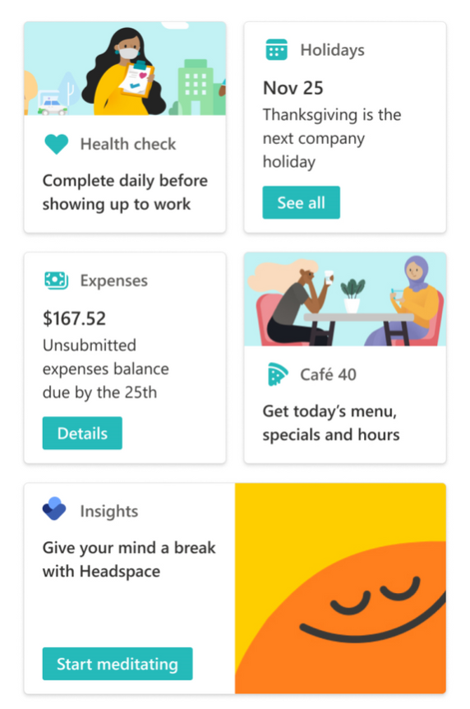
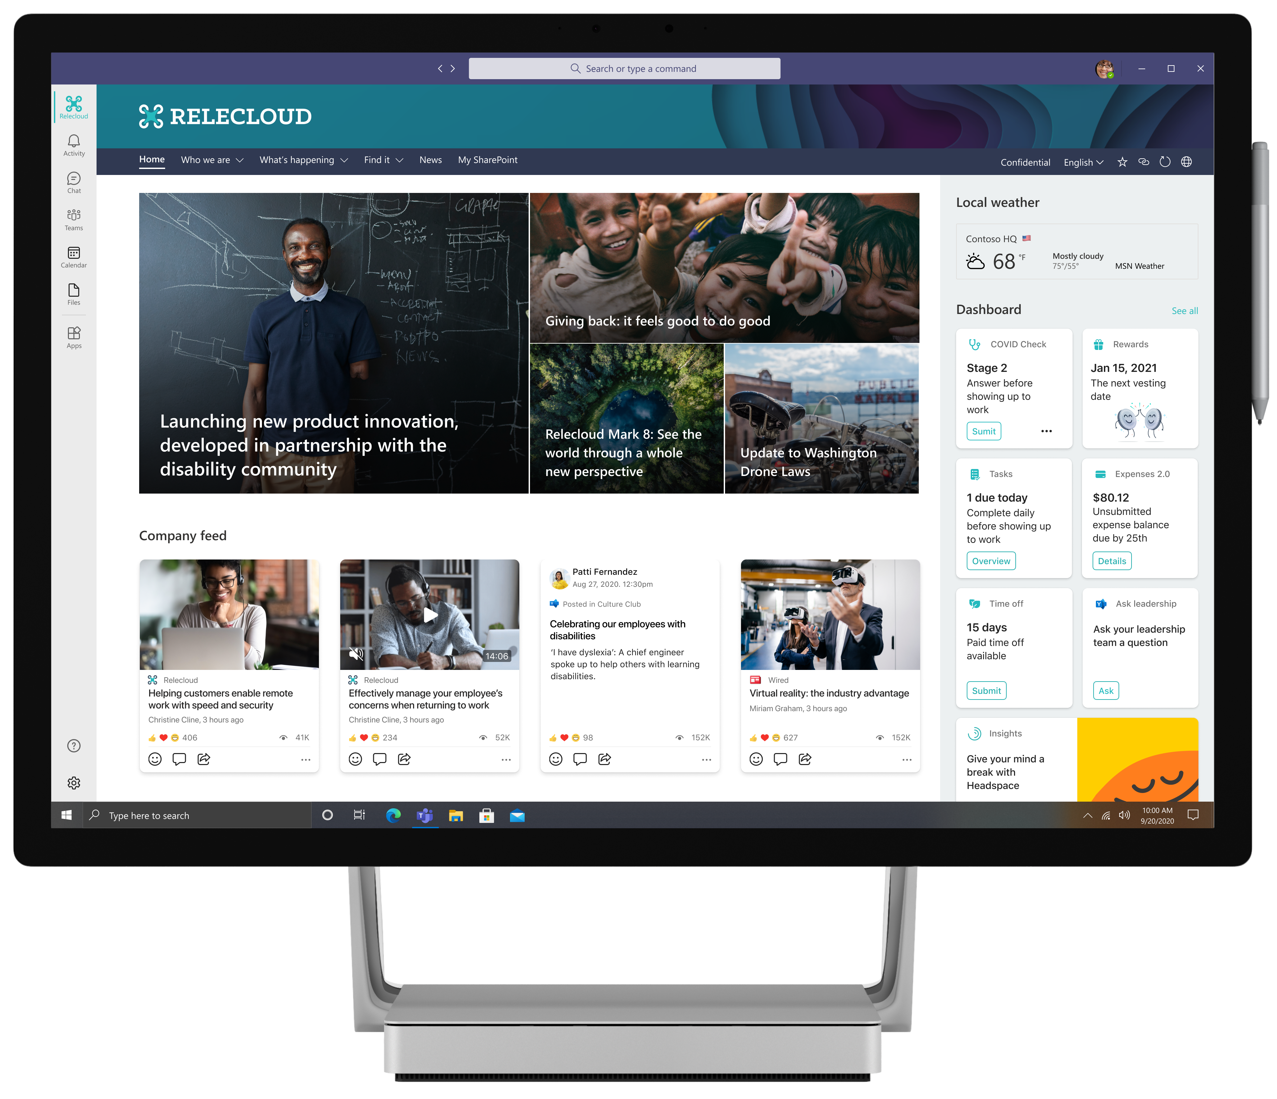
List and library form extensibility included!
UPDATE
SharePoint Framework 1.15 Release Candidate (RC) now available!
Release Candidate on the upcoming SharePoint Framework version now available with updated features for Microsoft Teams, Microsoft Viva and SharePoint Online
npm install -g @microsoft/generator-sharepoint@next
Notes:
Dan’s slide

Slide 12
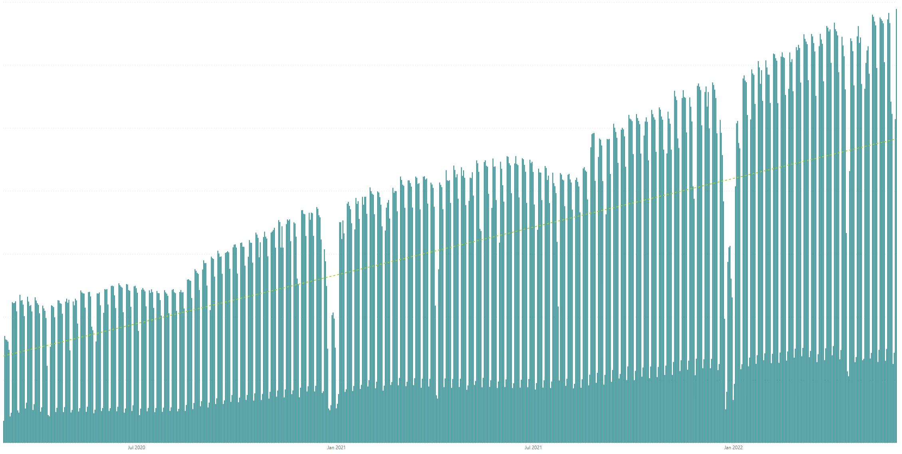

Rolling 28 days active users (MAU) for custom SharePoint Framework components in M365 There are currently tens of millions of monthly active users for customer and partner created SharePoint Framework components in Microsoft 365
All time highest usage in a day – Tuesday 31st of May 2022
Jul 2020
Jan 2021
Jul 2021
Jan 2022

Slide 13




The Road Ahead – 1.15 Release – ETA June 2022
Q2 CY 2022
1.15 release candidate (RC) – Released yesterday
New Action types for media and geolocation – Tutorial just published
Support for Microsoft Graph SDK V3
ESLint support
Support for TypeScript V4.5
Support for Teams SDK v1.12.1
Bug fixes and adjustments based on GitHub issues
New customizers for add and edit list / library forms
Available later as we progress in 1.15 development
Adaptive Card Extensions card view caching
Adaptive Card Extensions Error Handler Method
Adaptive Card Extensions card view caching – move to GA
Leverage Teams OBO flow for SPFx components in Teams Web
Enable Service Principal Registration in app acquisition flow
Isolated Adaptive Card Extensions (Beta)
Post 1.15 – 1.16 beta planned to get released in July
Bots Powered Adaptive Card Extensions (Beta)**
Support for Node V16 – Delayed unfortunately due to dependency on Office UI Fabric/Fluent version used in SharePoint Online*

Slide 14

PnPjs Client-Side Libraries

Slide 15
























PnPjs Client-Side Libraries
Version 3.4 to be released June 10th
General documentation updates
Updated packages
SchedulePublish added for client-side pages
Added paging support for graph library
Additional fixes and updates in the works
Don’t forget about the nightly builds
npm install @pnp/sp@v3nightly --save
Docs: https://pnp.github.io/pnpjs/ @m365pnpjs on twitter

Slide 16
CLI for Microsoft 365

Slide 17
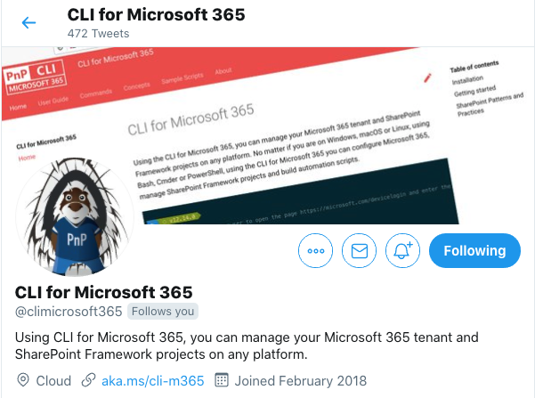
CLI for Microsoft 365
New version v5.3 with:
Managing list and list item permissions
Retrieving list of security alert for your tenant
Setting certificates on new and existing Azure AD apps
Easily opening the management page for an Azure AD app in the Azure Portal
Extended support for Planner
Install v5.3:
npm install -g @pnp/cli-microsoft365@latest
docker run --rm –it m365pnp/cli-microsoft365:latest
Release notes:
https://pnp.github.io/cli-microsoft365/about/release-notes/#v530
Available natively in Azure Cloud Shell
@climicrosoft365 #CLIMicrosoft365 on Twitter
📖 aka.ms/cli-m365
🗣 github.com/pnp/cli-microsoft365/discussions

Slide 18
SPFx Reusable Components

Slide 19
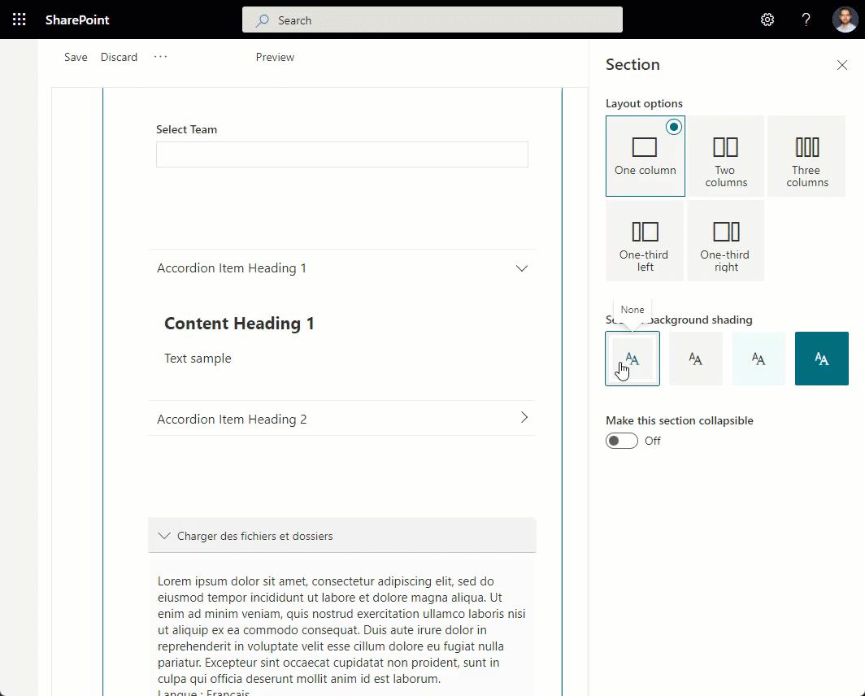
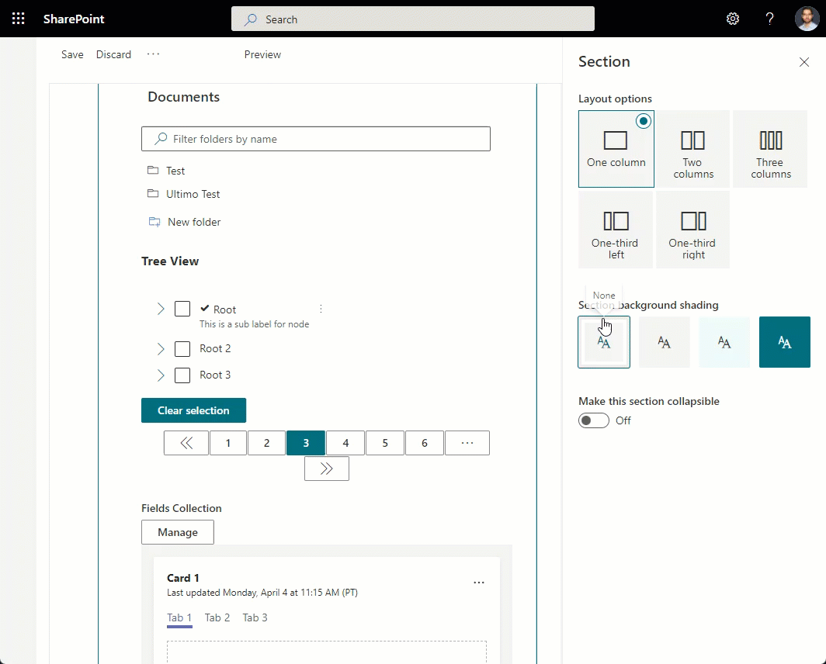
Reusable SPFx Controls
React Controls – 3.8.0
PeoplePicker enhancements: ability to provide multiple group id-s, search in nested groups
AdaptiveCardHost enhancements: add SPFx context, re-think CSS classes generation
Support for section backgrounds in AccessibleAccordion and TreeView
Various fixes
Release notes: https://pnp.github.io/sp-dev-fx-controls-react/about/release-notes/
React Property Controls – 3.7.0
PropertyFieldListPicker: ability to provide content type id
PropertyFieldColorPicker: provide preview of the selected color
Release notes: https://pnp.github.io/sp-dev-fx-property-controls/about/release-notes/
Special thanks to our contributors: Andreas Omayrat, brianpmccullough, Christophe Humbert, Fabio Franzini, Gautam Sheth, Joel Lopes, Milan Holemans, Patrik Hellgren, Ravichandran Krishnasamy, Rico van de Ven, Russell gove.
More information:
https://sharepoint.github.io/sp-dev-fx-property-controls https://sharepoint.github.io/sp-dev-fx-controls-react
Twitter: @M365PnPControls

Slide 20
PnP Modern Search

Slide 21
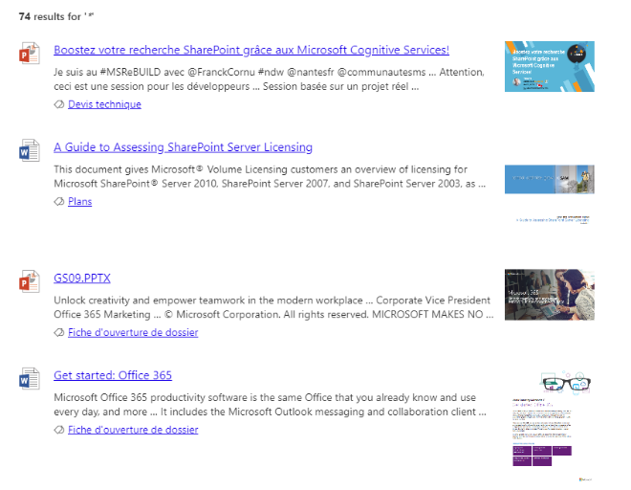

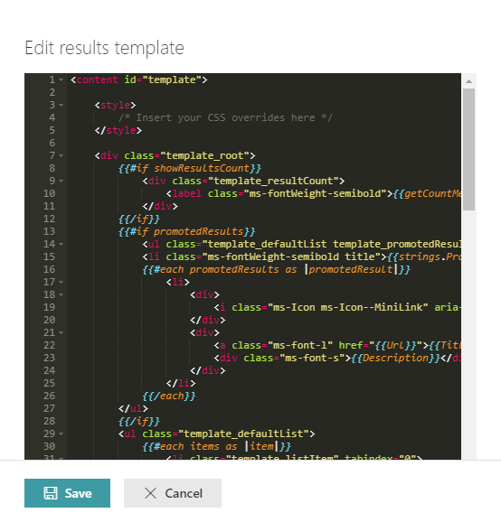
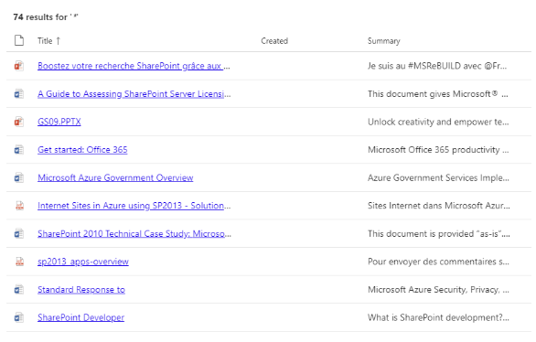


PnP Modern Search
http://aka.ms/pnp-search
Building modern Search experiences with flexible web parts
Adaptive Card support in the dev branch
v4.6.1 – April 2022 release
https://github.com/microsoft-search/pnp-modern-search/releases/latest
Thank you @gszdev, @kachihro, @edarroudi, @eduardpaul, @dominiqueborer, @kflogdev for your support 😍
See release notes for fixes and new features
v3.23.0 – December 2021 release
https://github.com/microsoft-search/pnp-modern-search/releases
See release notes for fixes and new features
Notes:
https://github.com/microsoft-search/pnp-modern-search

Slide 22

PnP SPFx Samples

Slide 23
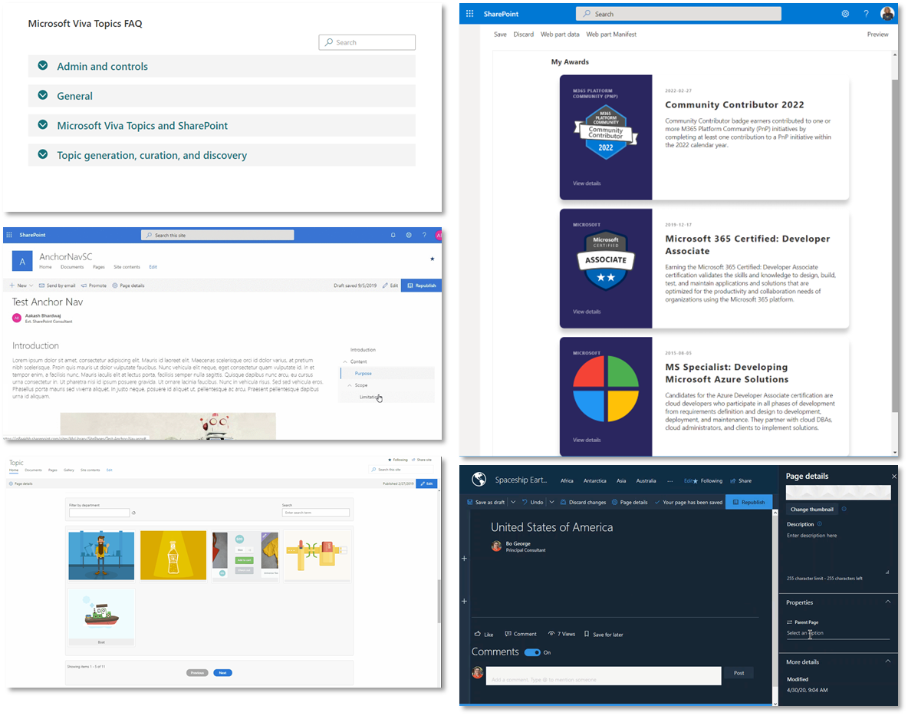
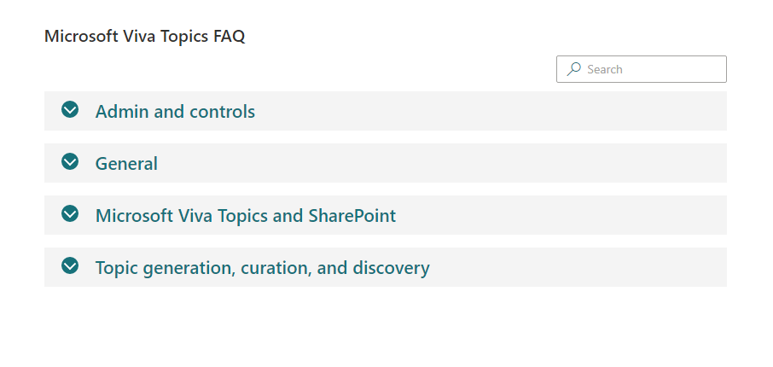
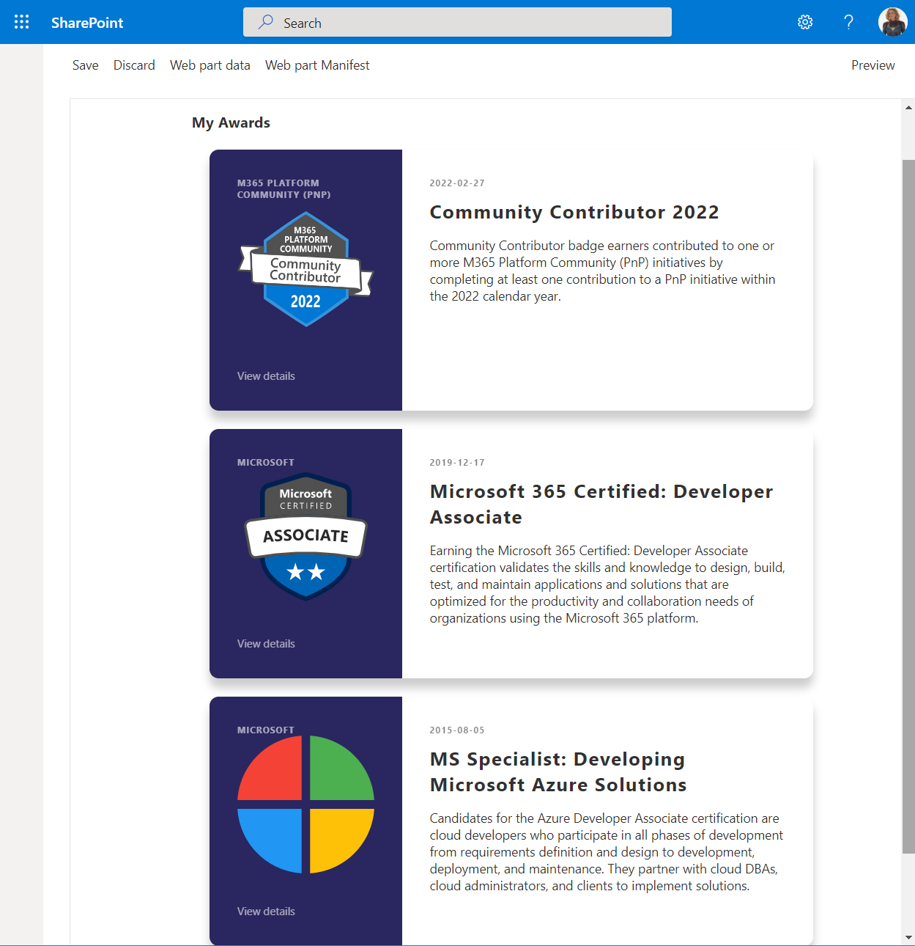
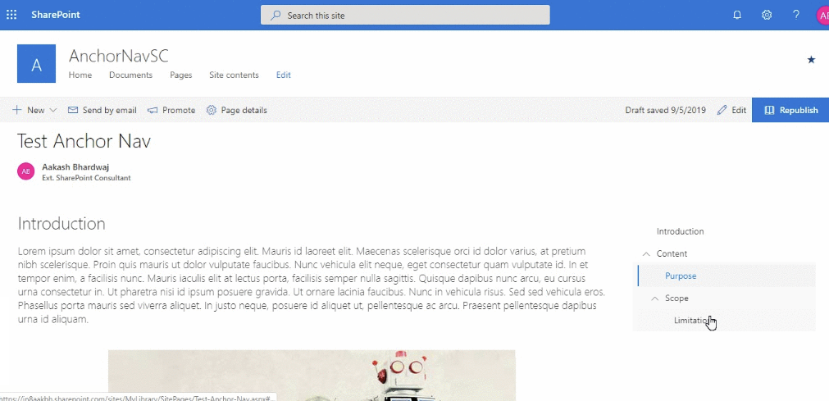
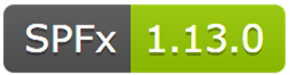
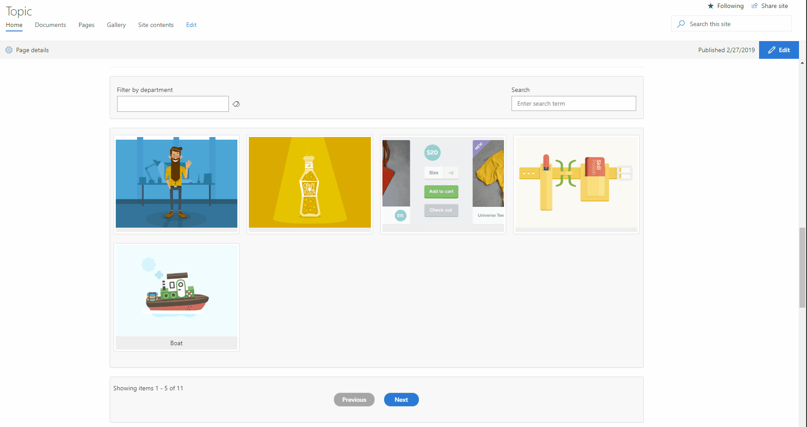
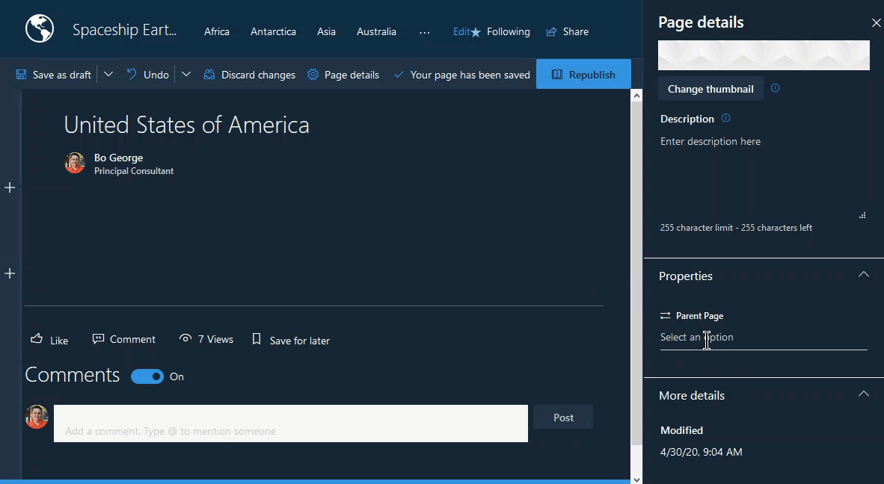
PnP SPFx Samples
PnP SPFx Samples
PnP SPFx Samples
https://aka.ms/spfx-extensions
Contributions welcome
https://aka.ms/spfx-webparts
Frequently Asked Questions with Property Field Collection Data Arun Kumar Perumal | arunkumarperumal
Pages Hierarchy Nick Brown | @techienickb
My Awards Luis Mañez | @luismanez
Filterable Image Gallery Ari Gunawan | arigunawan
Page Navigator Jasey Waegebaert | Jwaegebaert
ACE Strategy Pattern Marcin Wojciechowski | @mgwojciech
Follow Documents André Lage | @aaclage
💖 Denis Molodtsov | @zerg00s, Abderahman Moujahid | Abderahman88, Milan Holemans | milanholemans
Notes:
SPFx extensions https://aka.ms/spfx-extensions
NOPE
SPFx web parts https://aka.ms/spfx-webparts
Frequently Asked Questions with Property Field Collection Data Arun Kumar Perumal | arunkumarperumal
Updates to sorting on Categories
https://github.com/pnp/sp-dev-fx-webparts/tree/main/samples/react-faqs
Pages Hierarchy Nick Brown | @techienickb
Added support to allow upgrading from 1.0.0 to 1.0.3.
https://github.com/pnp/sp-dev-fx-webparts/blob/main/samples/react-page-navigator
My Awards Luis Mañez | @luismanez
This webpart is using the beta MS Graph Profile endpoint to list your awards. At the time of writing this sample (May 2022), this is a Beta endpoint, so it could change in the future. A future version of this webpart could include the ability to add new awards to your profile.
https://github.com/pnp/sp-dev-fx-webparts/tree/main/samples/react-graph-profile-awards/README.md
Filterable Image Gallery Ari Gunawan | arigunawan
Update SPFx version from 1.6 to 1.14
Update README with the latest template
Fix missing default value for the web part property
Remove unused codes
https://github.com/pnp/sp-dev-fx-webparts/tree/main/samples/react-image-gallery/README.md
ACE Strategy Pattern Marcin Wojciechowski | @mgwojciech
Marchin Wahjeekowski
This sample shows how to avoid conditions hell in quick view actions.
With more complex cards it can get extremely difficult to handle all the actions as adding more and more conditions to target action id impacts code readability.
https://github.com/pnp/sp-dev-fx-webparts/tree/main/samples/ace-strategy-pattern

Slide 24
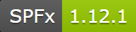
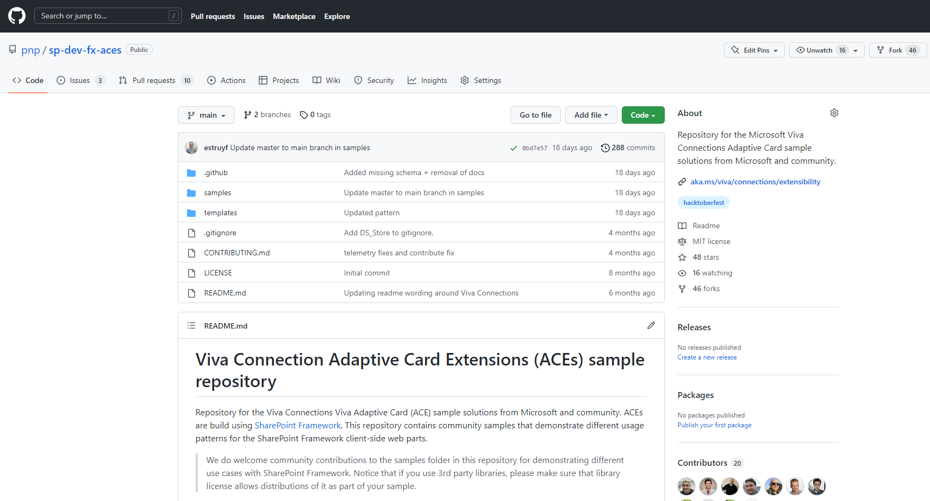
PnP SPFx ACEs
PnP SPFx Samples
PnP SPFx Samples
https://aka.ms/spfx-aces
UPDATES:
Office Locations – Image Card
Unread Emails – Primary Text Card
My Calendar Plan – Primary Text Card
News Feed – Primary Text Card Nick Brown | @techienickb
Additional PR's Being Processed
*** We Love New Samples ***
Follow Documents André Lage | @aaclage
Notes:
This adaptive card extension sample demonstrate ability to monitor security risks using identity protection graph api from Viva Connection Dashboard
SPFx extensions https://aka.ms/spfx-extensions
Copy/Move Items within Lists Sudharsan Kesavanarayanan | @sudharsank This application customizer will display a command button named Copy/Move Item(s) in all the custom lists. Using this option, the items can be copied or moved from one list to another within the site.
https://github.com/pnp/sp-dev-fx-extensions/tree/main/samples/react-command-copy-move-items
SPFx web parts https://aka.ms/spfx-webparts
Applications Secrets Expiration Aimery Thomas | @a1mery This sample web part shows the list of your applications registered in Azure AD along with their associated client secret/certificate expiration date. https://github.com/pnp/sp-dev-fx-webparts/tree/main/samples/react-graph-app-secret-expiration
Teams Membership Updater
Nick Brown | @techienickb
Fixed the /members in the private channel membership URL
Advanced Page Properties Abderahman Moujahid | Abderahman88
Added support for web parts on sites in a different language
NEW: News Alison Collins | ReactIntern Web part pulls all SharePoint News Posts that the logged in user has access to view.
Pagination ( Back/Next ) and Page Display ( n out of n )
Select Multiple Sites ( Defaults to site webpart is deployed to )
Two styling options, Stack or Single
News Title as link ( Click to go to post )
News Thumbnail Image
Preview of Description
Author ( Can toggle visibility in Property Pane )
Created Date
Likes with Office UI Fabric Icons
Comments with Office UI Fabric Icons ( Also retrieves nested comments )
https://github.com/pnp/sp-dev-fx-webparts/tree/main/samples/react-news

Slide 25



Optional picture time!
Video on and we’ll grab a Together Mode pic with those who are willing to do this.
We are together on this as a community!
Let’s all be like Seb?
By enabling your camera for the picture, you grant us permission to share your picture in social media.

Slide 26

DEMO
Frequently Asked Questions with Property Field Collection Data Arun
– Kumar Perumal
Solve Theme problems with the "Enhanced Theme Provider" PnP control
– Fabio Franzini
Getting started on building custom list forms with SharePoint Framework 1.15 - updated story
– Alex Terentiev
– Vesa Juvonen

Slide 27
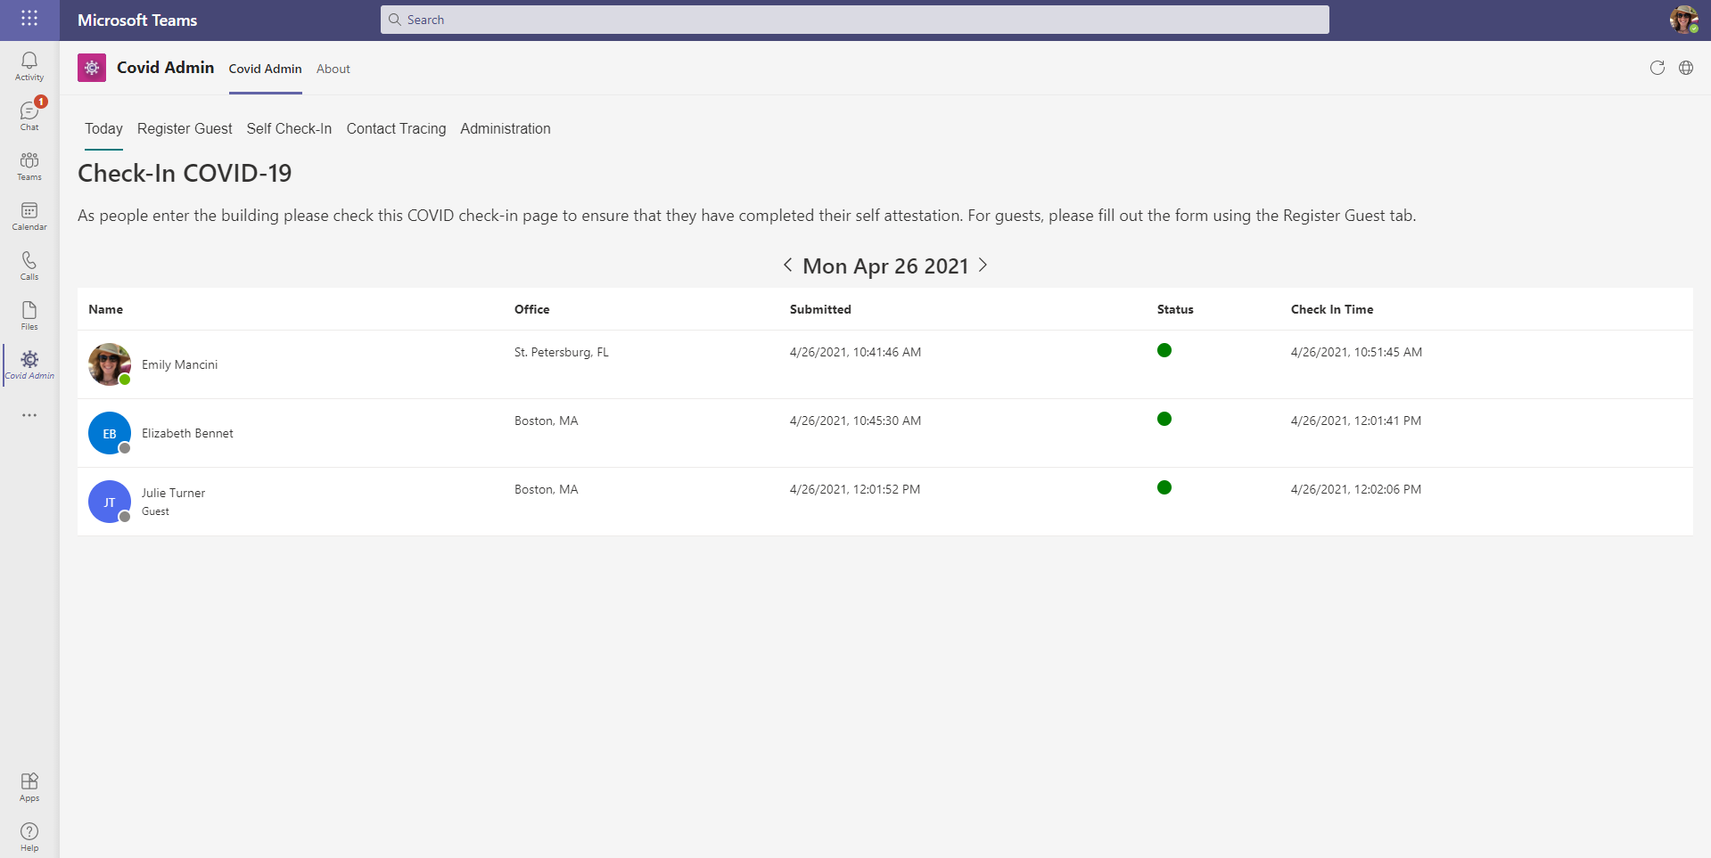
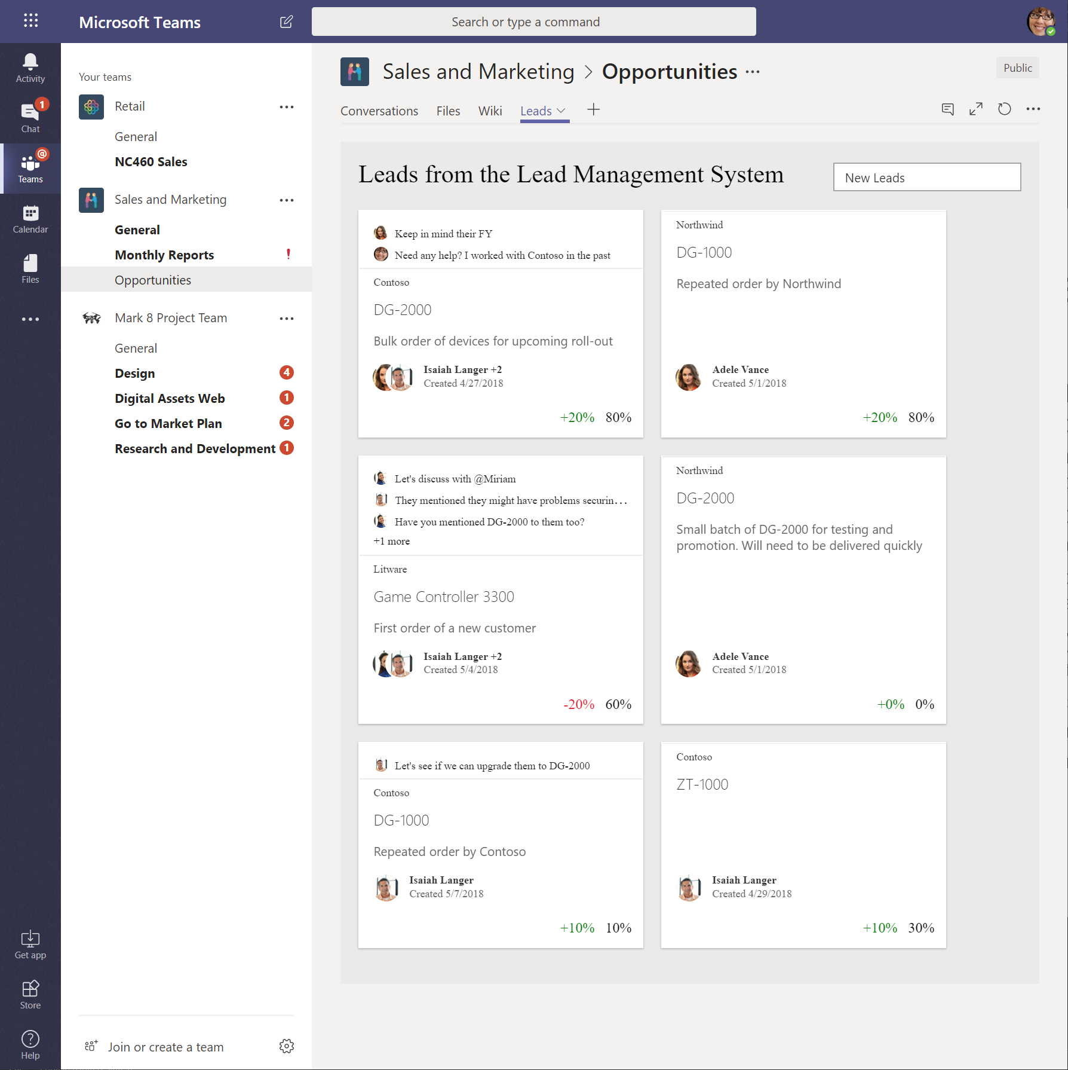
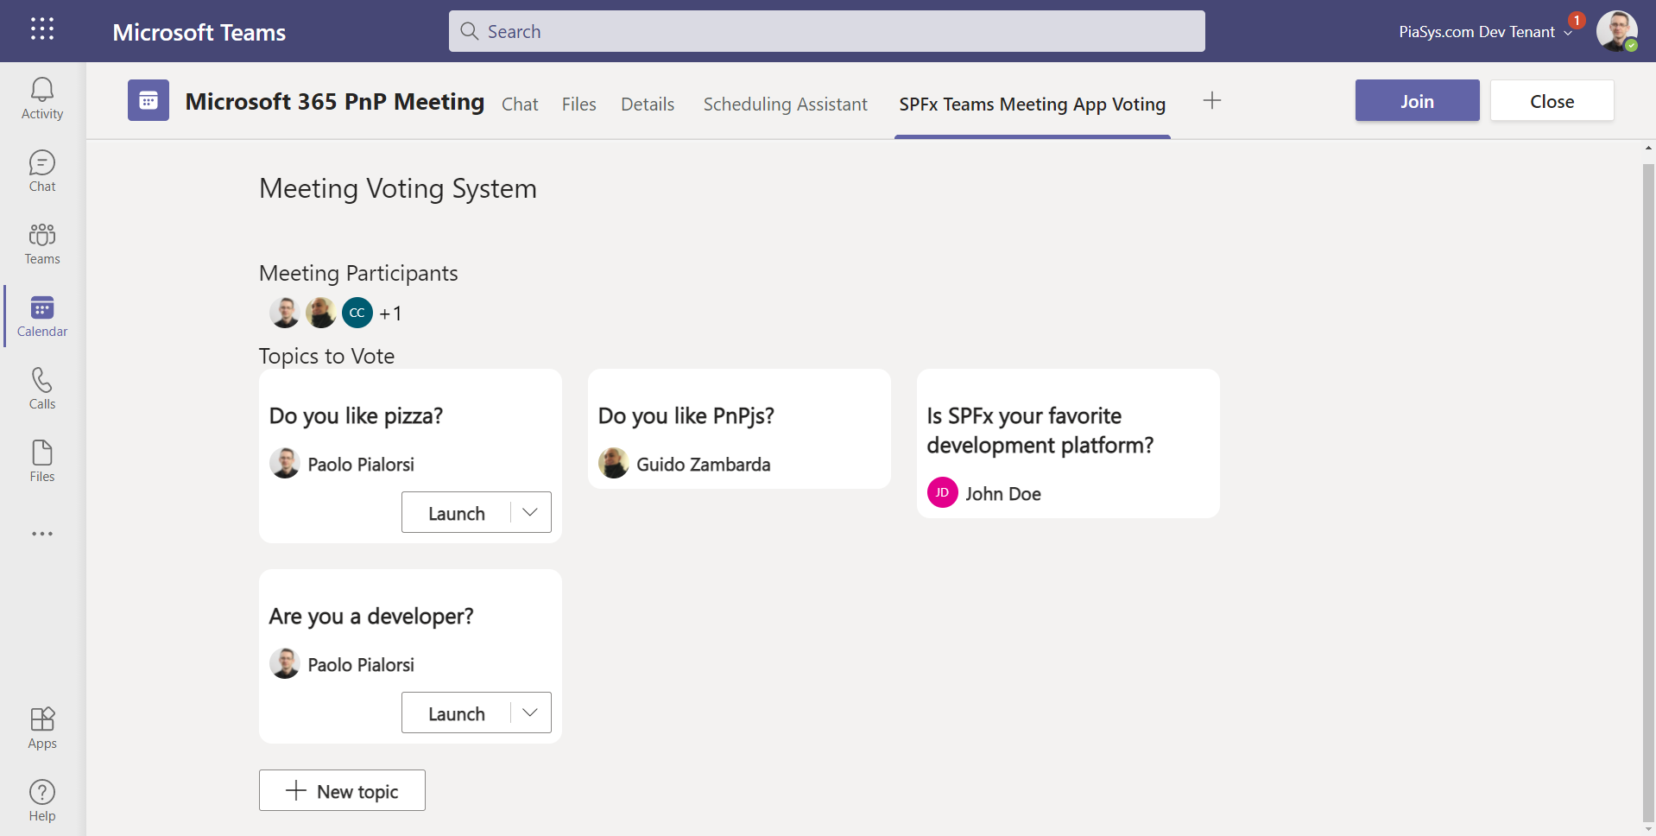
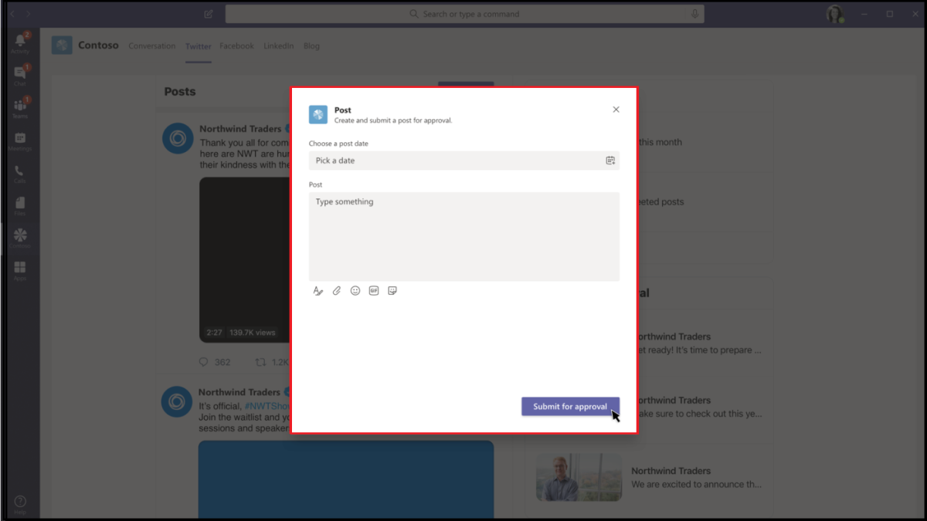
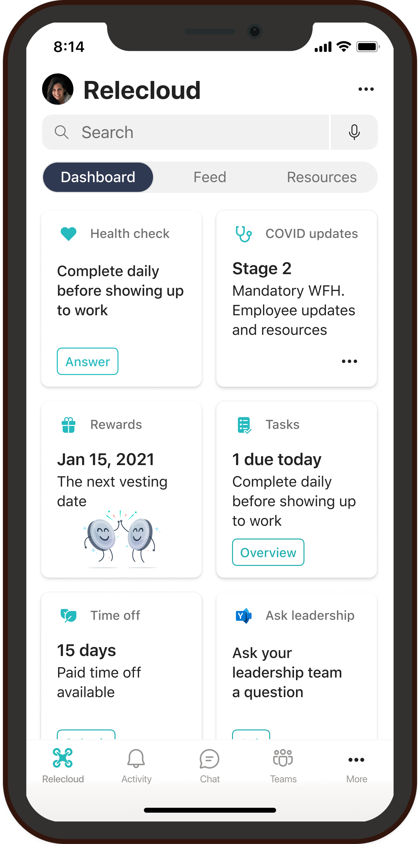
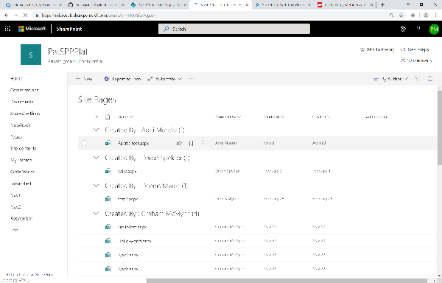
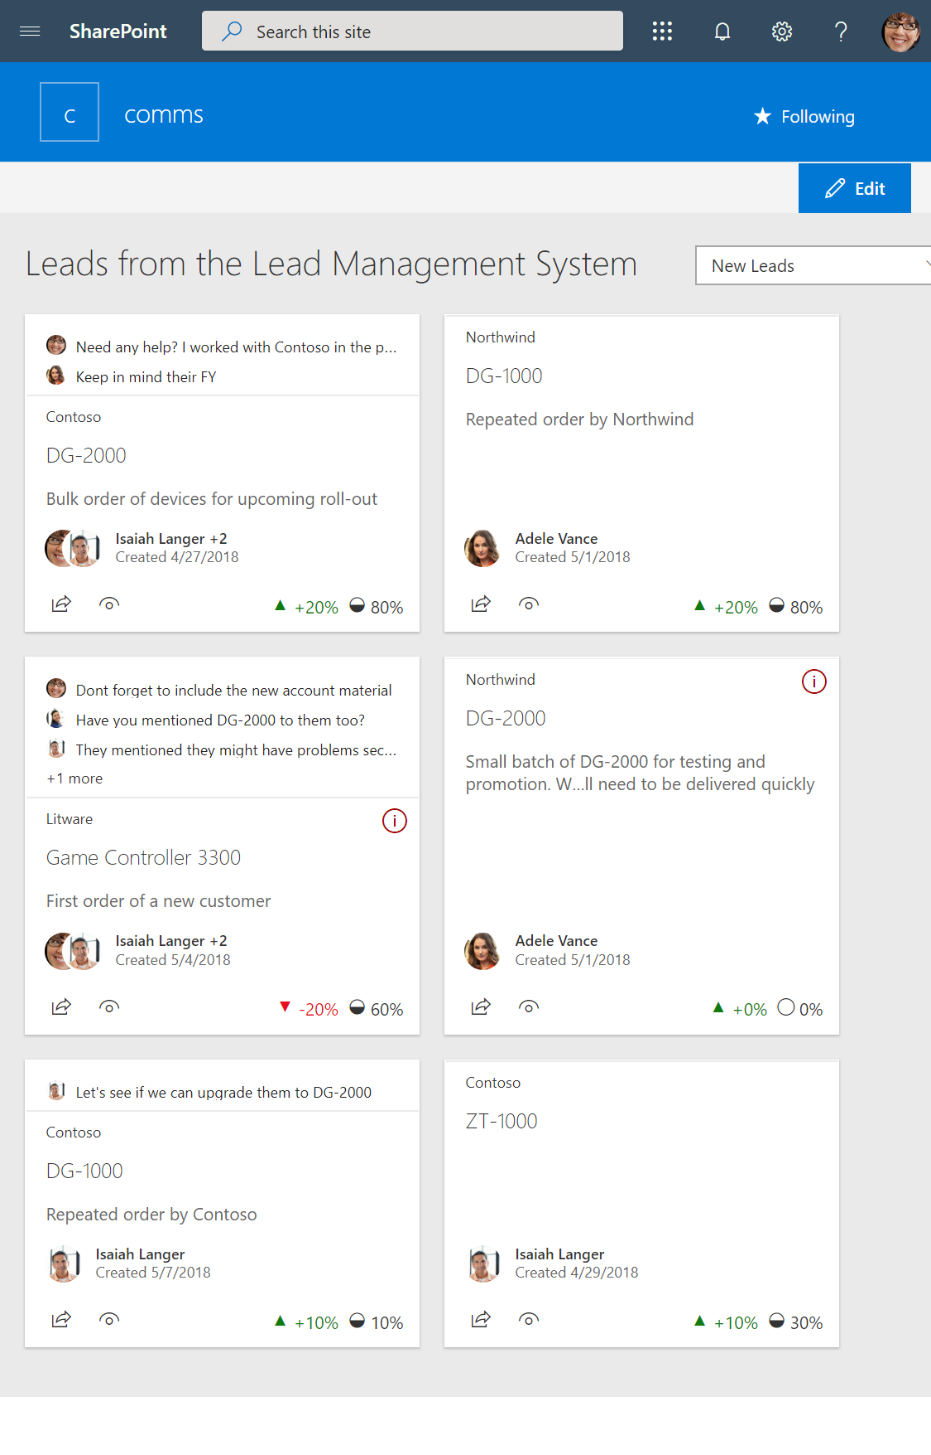
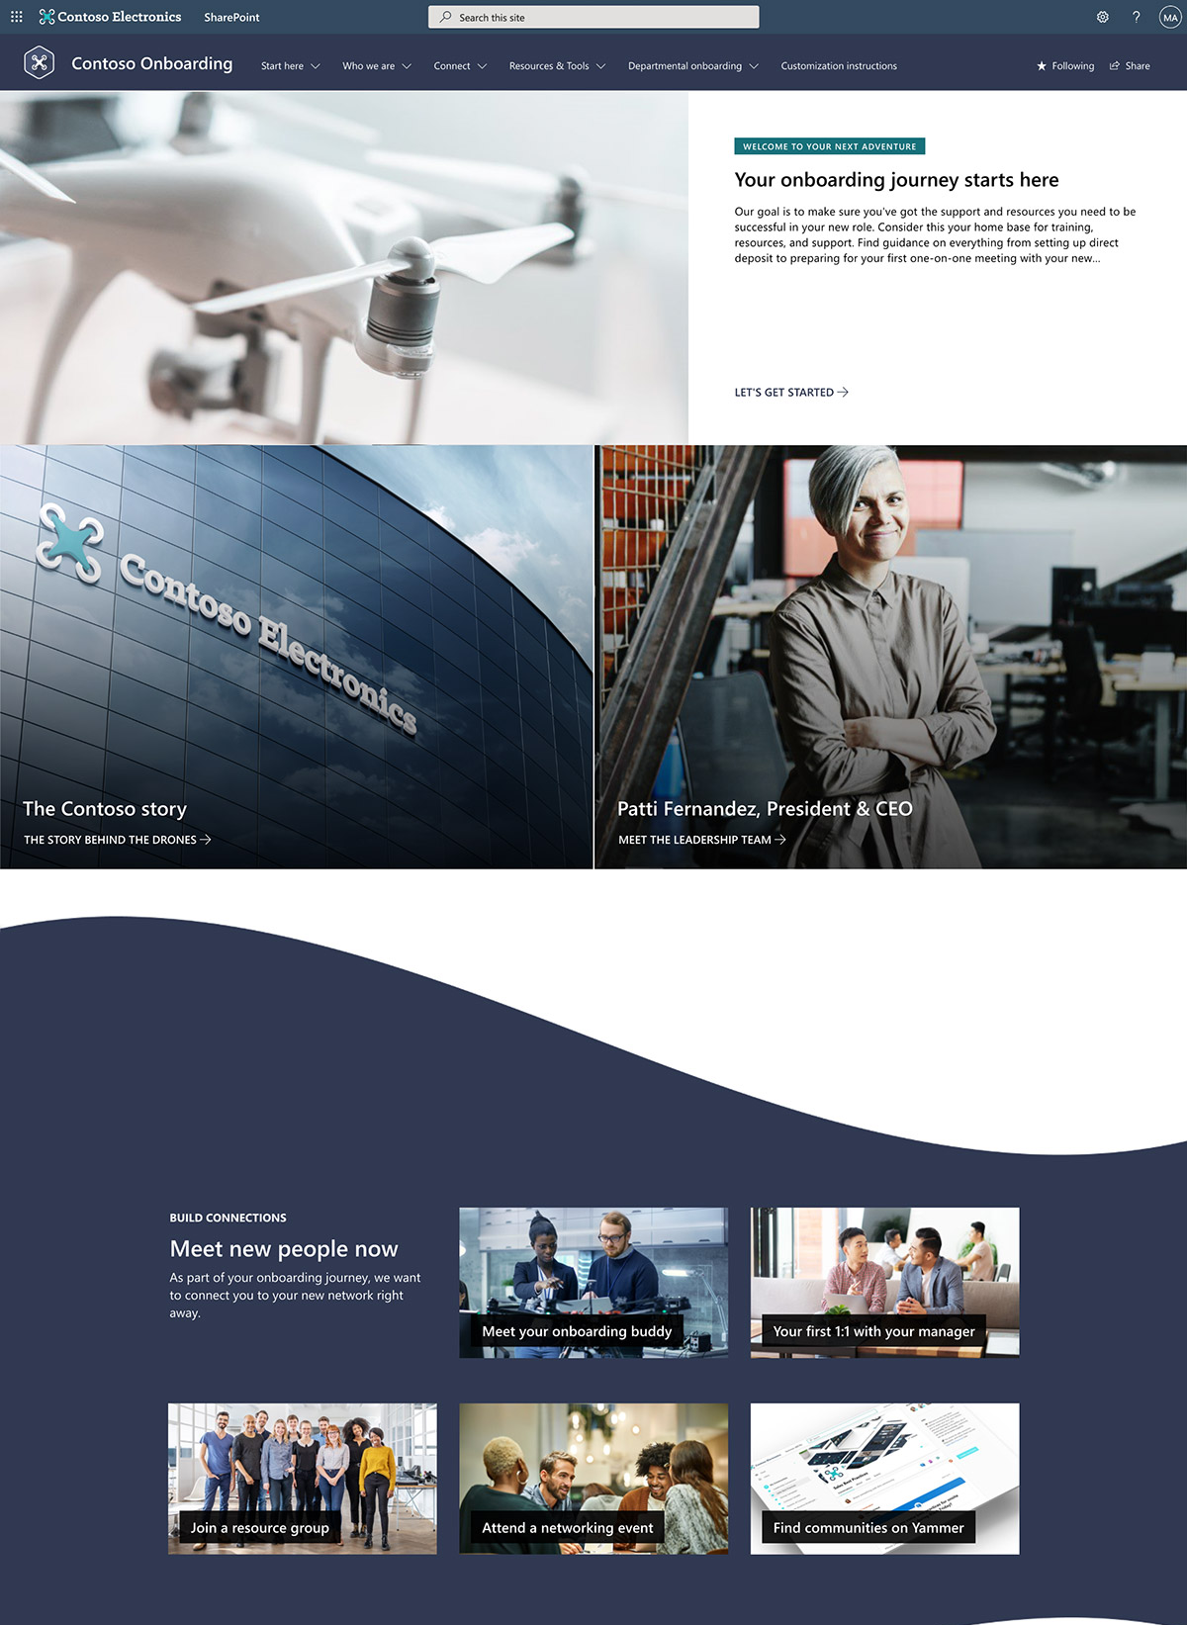
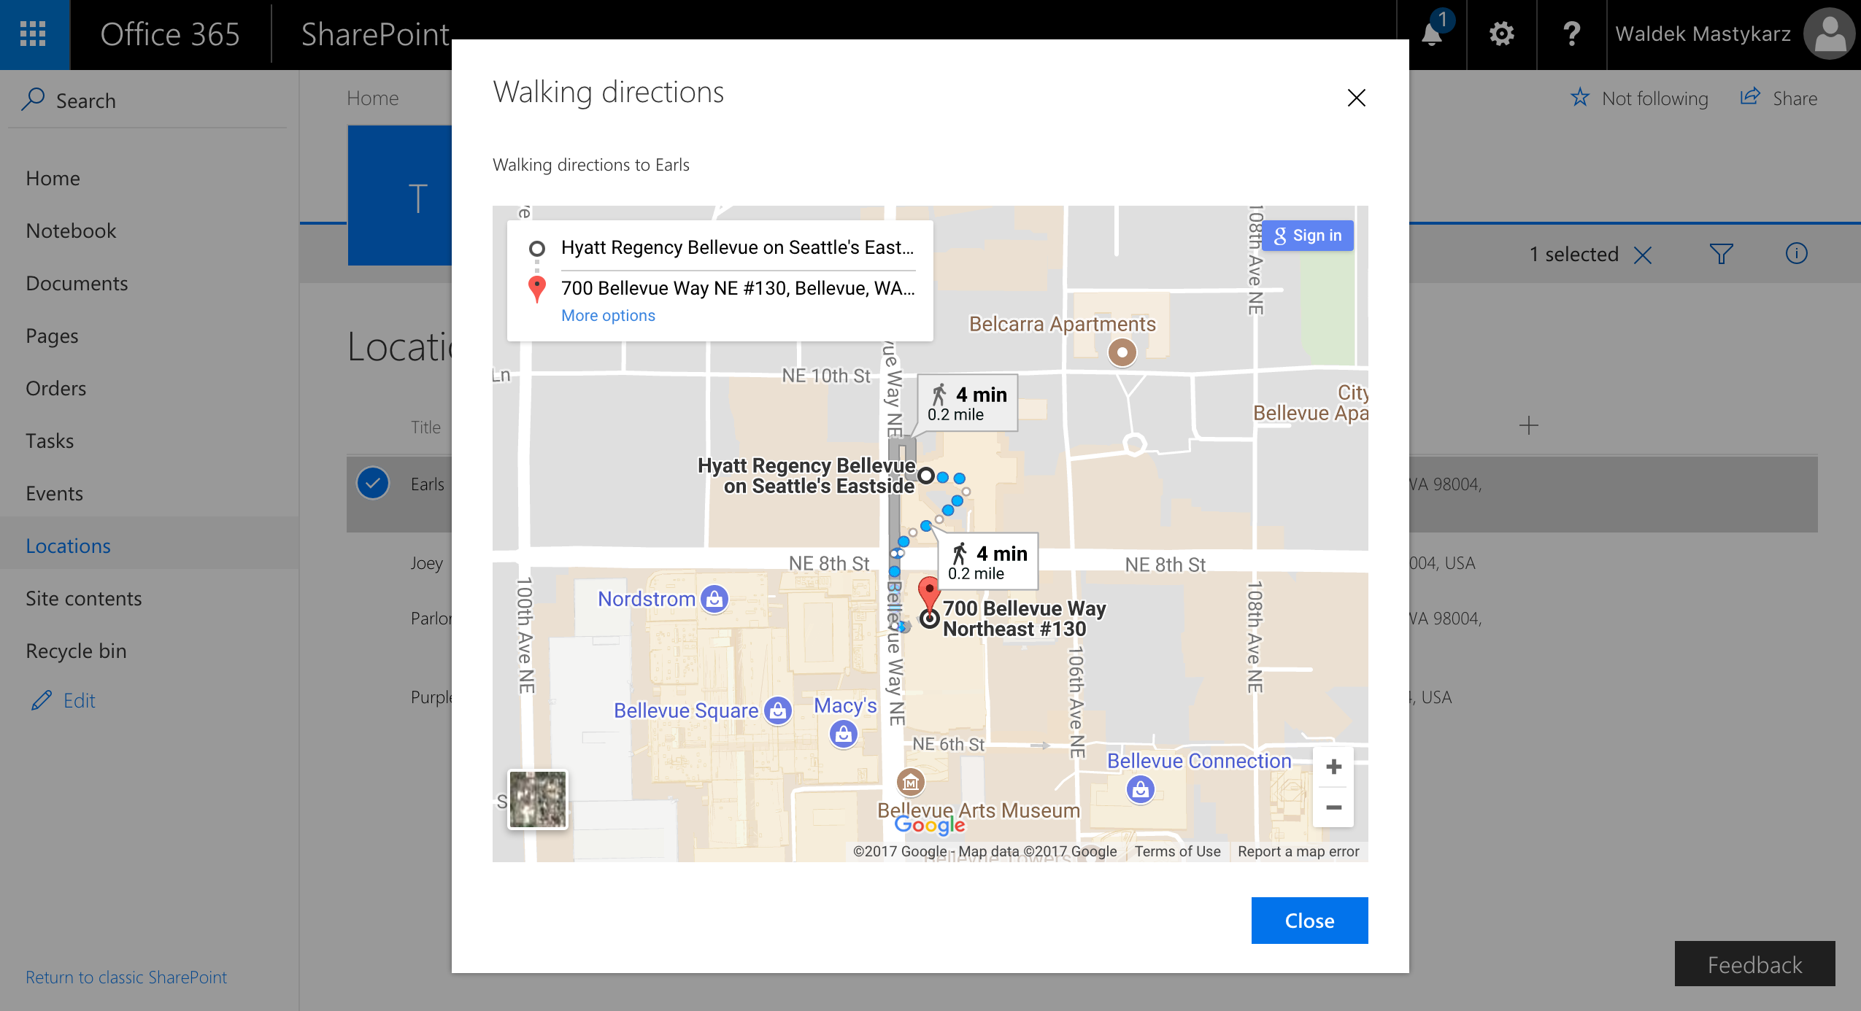
SharePoint Framework experiences in Microsoft 365 The easiest way to build your enterprise solutions for Microsoft Teams, Microsoft Viva and SharePoint Online
Microsoft Teams
Microsoft Viva Connections
Personal Apps
Teams tabs
Meeting apps
Messaging extensions
Cards
Web Parts
Extensions
App pages
SharePoint Online
Content driven applications | SSO | Automatic code hosting | Industry standard tooling
https://aka.ms/spfx
Notes:
We then extended the Framework to extend Teams in content driven experiences across Personal Apps, Teams Tabs and Meeting apps. This allows the entire SharePoint developer community to write content driven apps that work across mobile, web and desktop in Teams and Portals.
This year we introduced new card based extensibility allowing you to create no code apps in Viva Connections and take your existing Teams, SharePoint and Power Apps and target users in your organization with lightweight experiences through Adaptive Cards that take you to richer experiences.
Each time we add a new surface to the SharePoint framework we are honored to see more enterprise developers and ISVs show up to work with the stack. Thank you for continuing to invest your development time and dollars here.

Slide 28
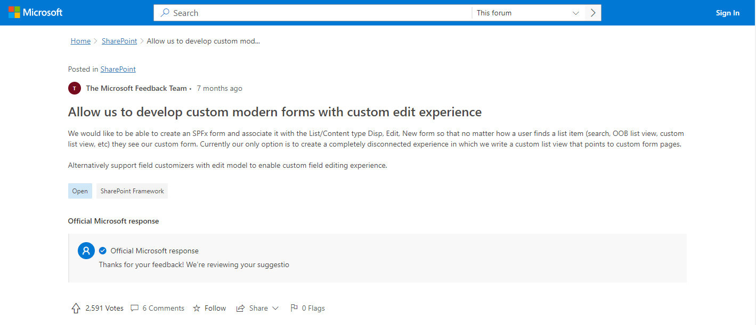

Slide 29
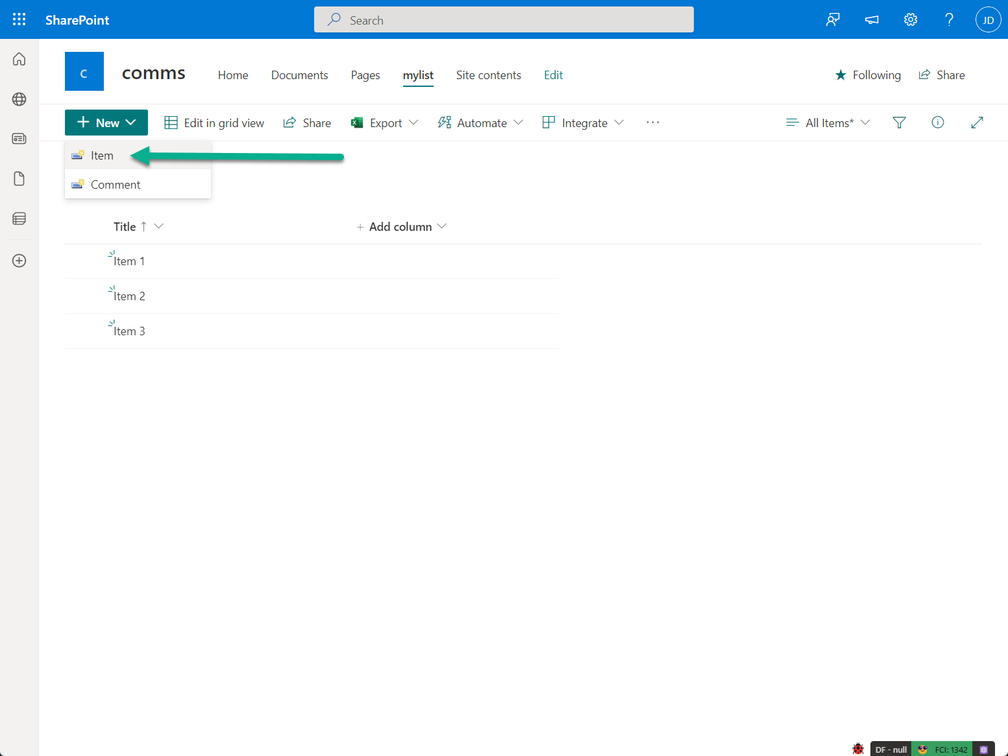
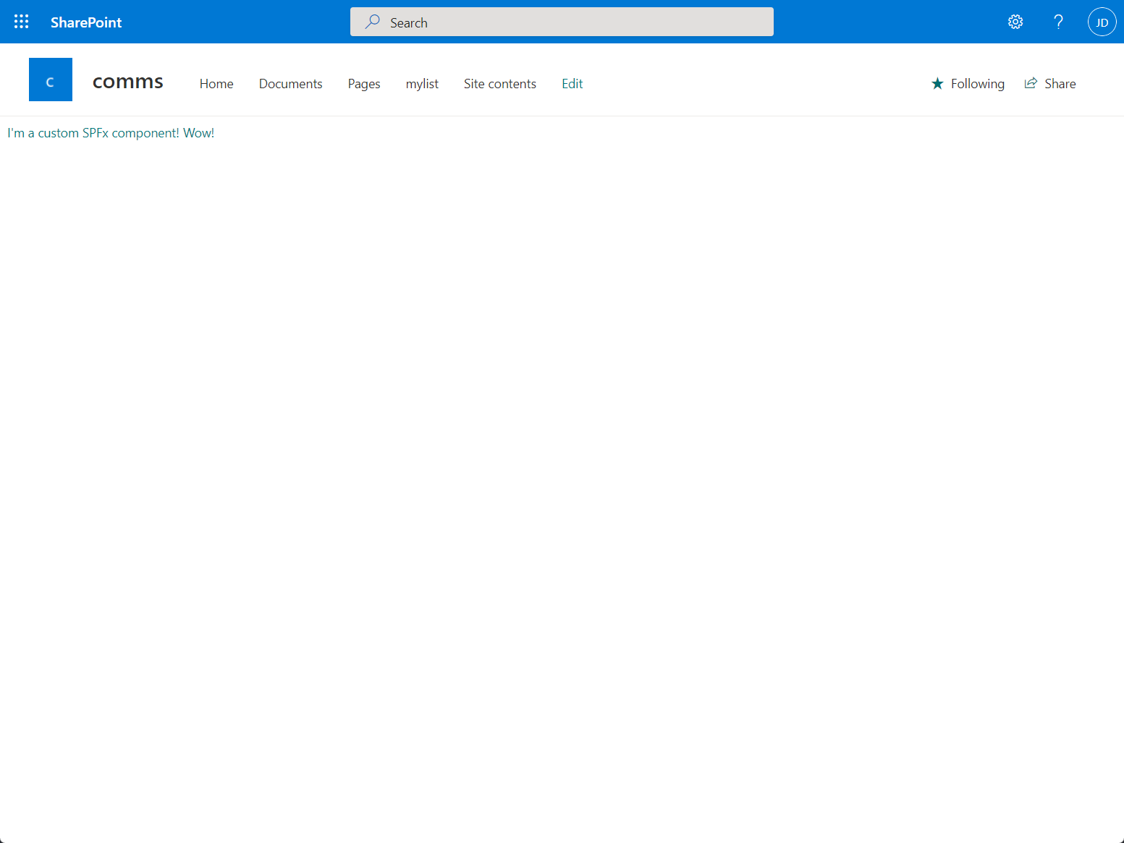
You will own the whole canvas and experience
You can access the context details in your code – with list details (and item id details)
Save and Close operations for you to call

Slide 30
API level support for in content types
Initially CSOM and REST API level support for associating the required components in the ContentType level
Microsoft Graph API support in roadmap
New properties
ContentType.NewFormClientSideComponentId
ContentType.NewFormClientSideComponentProperties
ContentType.DispFormClientSideComponentId
ContentType.DispFormClientSideComponentProperties
ContentType.EditFormClientSideComponentId
ContentType.EditFormClientSideComponentProperties
Included in CSOM NuGet starting from version 16.1.22518.12000 (May 31st 2022 forward)

Slide 31
DEMO Creating list form extension in SharePoint Framework 1.15 and test the deployment

Slide 32

List extensibility roadmap
Q2 CY 2022
Already out in 1.15 Release Candidate
Support overriding item level new, edit and view forms
Association done on the content type level – if exists in the list level, custom UX is rendered
API level support to associate custom rendering component at the content type level
Deployment support with elements.xml
Tutorial to get started with initial documentation
Items in the roadmap and next steps (No ETA)
Support showing custom components in the list context panel without requirement to move to separate view
Support on overriding the list default view – when listing numerous items in the list
Tenant wide deployment list support for the list extensibility components
Keep the feedback coming on what you need in this area as well

Slide 33
Thank you
Recording will be available in 24 hours on
Microsoft 365 Community (PnP) YouTube channel
https://aka.ms/M365/videos
(subscribe today)
Follow us on Twitter
@Microsoft365Dev | @M365PnP
Next Viva Connections & SPFx call: June 16th at 07:00am PT
Next M365 General Dev call: June 9th at 07:00am PT
All available community calls from https://aka.ms/m365/calls

Slide 34


aka.ms/m365pnp

